Slide 1
DXC GoodYear XX – AWS Design & Architecture (Proposed)
April 8th 2019

Slide 2


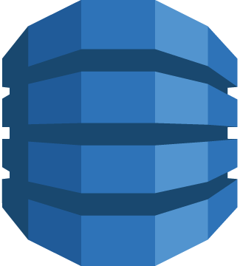
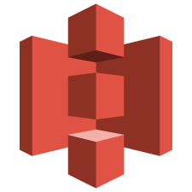



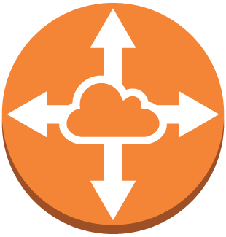




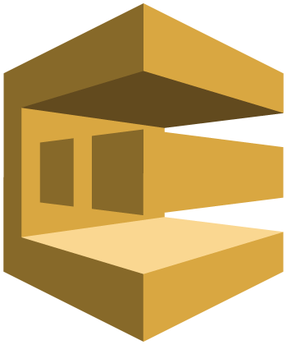

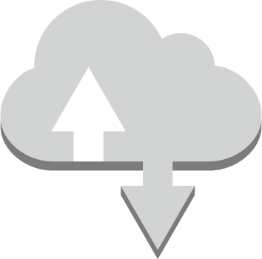
VPC Design Approach - Multi VPC Model
China / Singapore
Virtual private cloud (VPC) is logically isolated from other virtual networks.
VPC spans all the Availability Zones in the region and one or more subnets can be added in each Availability Zone.
It is highly recommended to create dedicated VPCs to host workloads with various risk postures, this will help to securely manage the whole environment
The VPC resources, access and security policies can be created & managed at the VPC level and that provide clear segregation in management & operations.
The non-production VPC used to deploy all Dev, testing, Integration workloads and production VPC used to deploy production and staging workloads.
It is proposed to have a separate VPC to manage the out-going internet traffic and it will act as a Demilitarized Zone (DMZ) with proxy server and NAT gateway deployed.
*Each VPCs need to have dedicated VPN connections for Data centres connectivity with unique CIDR blocks
AWS Endpoint Services
VPC
VPC
VPC
Production
Management
Non - Prod
VPC
Proxy
Internet Out
VPC Peering
NAT
AWS Internet Services
Endpoint Services
Internet Routable
Public Services
Internet

Slide 3

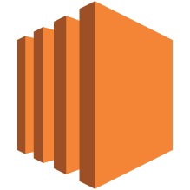


VPC Subnet Design Approach– Distribution for High Availability
China / Singapore
The AWS SLA specification for most of the services are not at the Availability Zone level and it is for whole region and hence it is the customer mandate to have High Availability deployment to achieve the required SLA.
It is highly recommended to distribute the subnets across different Availability Zone for the VPC and it is important to achieve the HA deployment.
VPC
Distributed Subnet
VPC subnet 1
VPC subnet 1
VPC subnet 2
VPC subnet 2
Availability Zone
Availability Zone

Slide 4



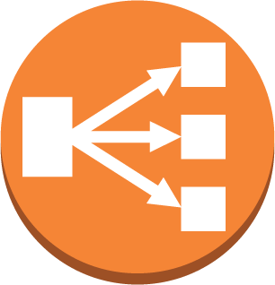
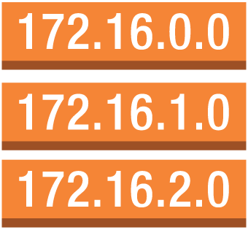


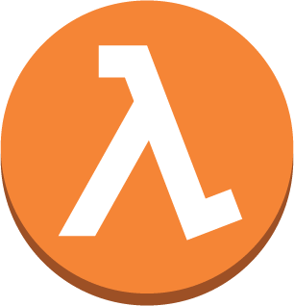



VPC Subnet Design Approach - Public, Private & Secured Subnets
Singapore / China
It is recommended to have a minimum three types of subnet.
One is with public (internet) access to deploy webserver, internet facing ELB
Application subnet to deploy the application server, middleware or data processing.
Secure subnet for database & other secure components.
There are different set of policies, security and compliance rules can be applied at the various subnet level.
*If there are no dedicated VPC for management, then It is preferred to have a separate subnet for management workloads
*If it is a single VPC model, then it is also proposed to have a dedicated subnet for production and Non-Production workloads
It is not required to associate the internet gateway for all the subnets that are designated as private. The internet access for these private subnet instance should be exposed through NAT & proxy and the incoming internet traffic should not reach these subnets directly.
CIDR
IGW
VPC
LB, Webserver (HTTP/S)
VPC Router
LB, Webserver (HTTP/S)
Destination | Target
10.0.0.0/16 | local
0.0.0.0/0 | IGW
Public Subnet A
Public Subnet B
Public NACL
OS, Appl., MW protocol
OS, Appl., MW protocol
Destination | Target
10.0.0.0/16 | local
Private Range | VGW
0.0.0.0/0 | NAT
Application Subnet A
Application Subnet B
Appl. NACL
OS, DB protocol
OS, DB protocol
DB, Secure Subnet A
VPC Router
DB, Secure Subnet B
Secure NACL
Availability Zone
Availability Zone

Slide 5


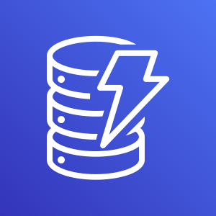
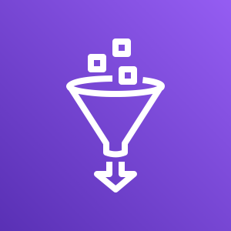






Cloud Connectivity – Development (Singapore)
Singapore
IAM
VPC End point
Public Routing Services
Internet Routing for AWS management console & API access
Need of VPN connection
Private subnets will go through public subnets
Tableau should access redshift through VON over internet
S3
VPC
Management, Production & Non Production
Dynamo
Secured Subnet (Private)
Public Subnet
VPC End Points
Application Subnet (Private)
Glue
Athena
MPLS / VPLS / VPN over Internet
Internet
Internet Routable (Private subnets has to be routed through Public (NAT Gateway)
Public API & AWS Console
GY DC & Office Location
User Interface / Development Interface
Notes:
Message
Resources integration using MPL extension across cloud provider and office location
Again, the resources has to be managed through public API – That’s the only option

Slide 6
Cloud Connectivity – Production (China)
China
IAM
Everything else remain same, but here Tableau online access the Redshift over internet routing, redshift has to be exposed in public
VPC End Points
S3
VPC
Management, Production & Non Production
Dynamo
Secured Subnet (Private)
Public Subnet
Application Subnet (Private)
Glue
Athena
Internet
Internet Routable (Private subnets has to be routed through Public subnet)
MPLS / VPLS / VPN over Internet
Public API & AWS Console
GY DC & Office Location
User Interface / Development Interface
Tableau Online (SaaS)
Notes:
Message
Resources integration using MPL extension across cloud provider and office location
Again, the resources has to be managed through public API – That’s the only option

Slide 7
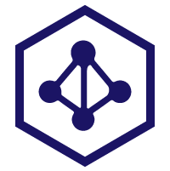







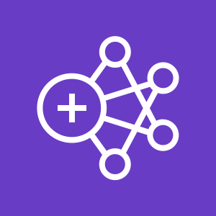
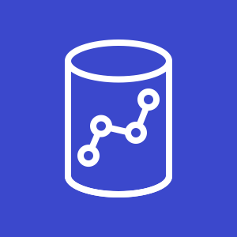



Proposed Deployment – Development (Singapore)
Prototype
Future
Mobile Device
Internet Routing
Delegated User Identity (SAML, OpenID)
Security Tokens
1
Credentials & Privileged Role
IAM
Corporate Directory
Browser Client / API
VPC
AZ 1
S3
Application Subnet
Secured Subnet
Public Subnet
2
Event Driven
Trigger
RedShift
Push Files
EMR
Fetch
3
4
Output
VON over Internet
IAM Roles – Both user and API access
Output
AZ 2
Application Subnet
Secured Subnet
Public Subnet
S3
AWS Console
5
VPN over Internet
Corporate data center
Notes:
Message
Resources integration using MPL extension across cloud provider and office location
Again, the resources has to be managed through public API – That’s the only option

Slide 8
Proposed Deployment – Production (China) – Option 1
Prototype
Future
Mobile Device
Internet Routing
Delegated User Identity (SAML, OpenID)
Security Tokens
1
Credentials & Privileged Role
IAM
Corporate Directory
Browser Client / API
VPC
AZ 1
S3
Application Subnet
Secured Subnet (Public)
Public Subnet
2
Event Driven
Trigger
RedShift
Push Files
EMR
Fetch
3
4
Output
xx
Output
AZ 2
Application Subnet
Secured Subnet (Public)
Public Subnet
S3
AWS Console
5
Corporate data center
Tableau Online
Notes:
Message
Resources integration using MPL extension across cloud provider and office location
Again, the resources has to be managed through public API – That’s the only option

Slide 9

Proposed Deployment – Production (China) – Option 2
Prototype
Future
Mobile Device
Internet Routing
Delegated User Identity (SAML, OpenID)
Security Tokens
1
Credentials & Privileged Role
IAM
Corporate Directory
Browser Client / API
VPC
AZ 1
S3
Application Subnet
Secured Subnet
Public Subnet
2
Event Driven
Trigger
RedShift
Push Files
EMR
Fetch
3
4
Output
xx
Output
AZ 2
Application Subnet
Secured Subnet
Public Subnet
S3
SSH / Reverse Proxy
AWS Console
5
Corporate data center
Tableau Online
Notes:
Message
Resources integration using MPL extension across cloud provider and office location
Again, the resources has to be managed through public API – That’s the only option

Slide 10

www.dxc.technology

Slide 11
Appendix

